Slide 1

ZOMATO EXPANSION
Submitted By:- Shubham Sharma shubhamsharma8287@gmail.com

Slide 2
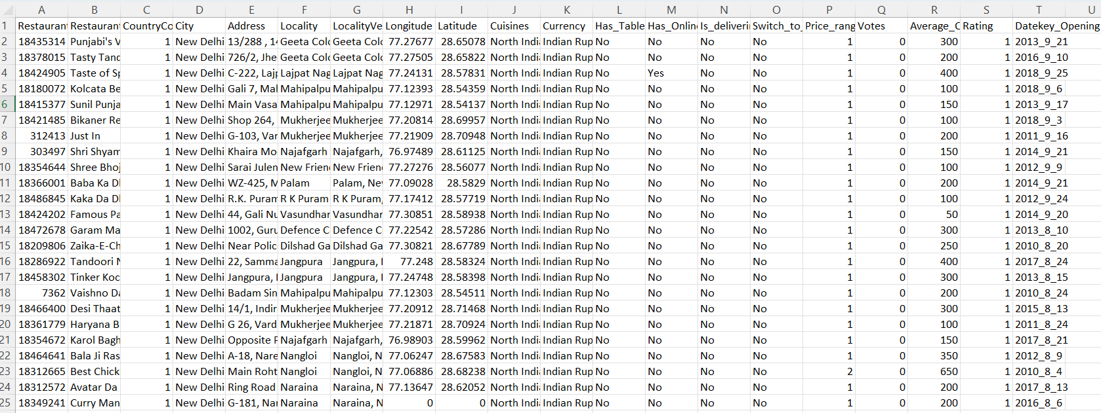
PROBLEM STATEMENT
You are hired as a consultant data analyst by Zomato where the team is looking for expansion and opening more restaurants. Your task is to develop strategies/suggestions for opening newer restaurants.

Slide 3
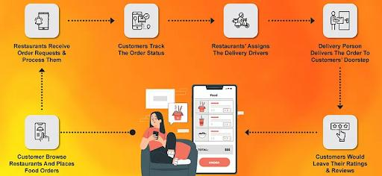
Zomato Workflow
Zomato is one of the leading food delivery platform where people can search restaurants, search cuisines, order food to their door step, give review and upload photos of food and restaurants. It serves in more than 1000+ cities in India

Slide 4
Zomato Restaurant Data
Total number of restaurants: 9527 across various cities in the globe
Total number of high rated restaurants (Above 4): 1380
Country with most number of high rated restaurants: India
Restaurant with the highest vote: Toit, India
Analyze rating and vote to understand which restaurants are highly rated
Identify popular cuisines in different cities based on user rating
Examine the restaurants based on price range and relates with vote
Analyze user preference in delivery vs dine-in

Slide 5
ANALYSIS OBJECTIVE
Scout for new locations where Zomato can launch restaurants and expand their business footprint.
Suggest new markets based on their unique characteristics using various data analysis strategies.
Evaluate the competition to identify the most lucrative markets for expansion.
Present year-over-year data to analyze market trends and make informed decisions for launching new restaurants.
Analyze restaurant ratings in targeted locations to gain deeper insights into market preferences and conditions.

Slide 6
ZOMATO DATASET OVERVIEW
S No. | Columns | Description
1 | Restaurant ID | Unique identifier for each restaurant.
2 | Restaurant Name | The name of the restaurant.
3 | CountryCode | Country code of the location where the restaurant is situated.
4 | City | The city where the restaurant is located.
5 | Address | The specific address of the restaurant.
6 | Locality | The locality or neighbourhood where the restaurant is situated.
7 | Locality Verbose | Detailed information about the locality.
8 | Longitude | The geographical longitude coordinate of the restaurant.
9 | Latitude | The geographical latitude coordinate of the restaurant.
10 | Cuisines | The type of cuisine offered by the restaurant.
11 | Currency | The currency used for transactions in the restaurant.
12 | Has_Table_booking | Indicates whether the restaurant has a table booking option (Yes/No).
13 | Has_Online_delivery | Indicates whether the restaurant offers online delivery (Yes/No).
14 | Is_delivering_now | Indicates whether the restaurant is currently delivering (Yes/No).
15 | Switch_to_order_menu | Indicates whether users can switch to the order menu (Yes/No).
16 | Price_range | A numeric value indicating the price range category of the restaurant.
17 | Votes | The number of votes or ratings/(feedback) received by the restaurant.
18 | Average_Cost_for_two | The average cost for two people dining at the restaurant.
19 | Rating | The overall rating of the restaurant is based on user reviews.
20 | Datekey_opening | The date when the restaurant was opened.
21 | Country Code | The code assigned to a specific country that helps identify the country in raw data.
22 | Country Name | The respective country for the given country code.
23 | Countries_description | This sheet has all the country name alongside their international codes.

Slide 7
METHODOLOGY
Data Cleaning
Descriptive
Visualization
Competitor Analysis
Data Enrichment
Removed null and empty values which could hamper our analysis, such as in some places “cuisines” cell was empty.
Enhanced the dataset with additional variables like VLOOKUP to cross reference country.
Employed Pivot Tables for key metrics and identifying the competitor restaurants and top cuisines.
Identifying the competitors in the suggested areas.
Created dynamic charts and dashboard for data representation, enabling interactive data exploration

Slide 8
Restaurants Opened
India has the majority of the total restaurants with 8652, which is about 90.55% of the total.
United States of America has the significant count of restaurant with 434, which is still less than average count of restaurant 636.
Data shows very low count of restaurants in popular tourist destinations Qatar, Canada, Singapore, Sri Lanka
Considering opening new restaurants in popular tourist countries

Slide 9
Year Wise Opening
Data on the number of restaurants that opened each year from 2010 to 2018, with a total of 9,527 restaurants
Trends:
Highest number of openings: The year 2018 had the highest number of restaurants opened, with 1,101.
Lowest number of openings: The year 2012 had the lowest number of restaurants opened, with 1,019.
Overall, the number of restaurant openings remained relatively stable over the years, with a slight increase in the latter years, particularly in 2017 and 2018.

Slide 10
Average Of Voters Vs Country
Indonesia has the highest number of voters. Even after being a less population country and less number of restaurant present.
Brazil and Singapore has the lowest number of voters with only 20 & 32 average voters respectively.
We can see that even India has the highest number of restaurants with very high population, the number of voters are very less.

Slide 11
Suggested Cities with Average Rating
To maximize success of new restaurants we can further study the average ratings in the target countries.
We can see that Qatar has high rated restaurants with average rating of 4.1.
Sri Lanka is not far behind with 3.9.
Canada and Singapore has the same average rating of 3.6
By observing this we can conclude that we will require high budget and efforts in new restaurants in Qatar.
Singapore, even with high average food expenditure, have restaurants with ordinary quality.

Slide 12
Average cost for Two
The metric we are going to use is average cost for two, places where this cost is high, we can have higher profits, we can use this metric to further narrow down our focus to certain cities.
In Canada, we can see that Vineland Station is the best location because it fits our game plan perfectly.
Doha apart from being a major population center for Qatar, also houses a very lucrative food market and have low saturation.
Singapore is a city-state so geographically and financially it makes no sense to not open new restaurants there, as saturation is low and food expenditure is the highest in our suggestions list.
Colombo, has the least food expenditure of all suggested countries, but what it does have is large population and relatively less number of restaurants serving them.

Slide 13
Has Online Delivery or Not ?
Key Insights:
Majority of restaurants do not offer online delivery: 7,076 out of 9,527 restaurants (about 74%) do not offer online delivery.
A significant portion does offer online delivery: 2,451 restaurants (about 26%) offer online delivery.
This suggests that while online delivery is a growing trend, it still represents a minority of the total restaurants in your dataset.
Has Table Booking or Not ?
Key Insights:
Most restaurants do not offer table booking: 8,369 out of 9,527 restaurants (about 88%) do not offer table booking.
A smaller portion offers table booking: 1,158 restaurants (about 12%) offer table booking.
This suggests that table booking is less common compared to other restaurant features like online delivery.

Slide 14
PRICE RANGE
Key Insights:
Price Range 1 has the largest number of restaurants: 4,423 restaurants (about 46%) fall into the lowest price category.
Price Range 2 follows closely with 3,113 restaurants (about 33%), representing the next most common price range.
Price Range 3 has 1,405 restaurants (about 15%), and these are priced higher than those in Range 1 and 2.
Price Range 4 has the fewest restaurants: 586 restaurants (about 6%), which suggests that high-end or luxury restaurants are the least common in the dataset.
Summary:
The majority of restaurants fall into the lower price ranges (1 and 2), making up about 79% of the total.
Higher-end restaurants (Price Range 3 and 4) make up the remaining 21%.

Slide 15
Recommendations
We can see that Canada, Singapore, Sri Lanka and Qatar are countries with the least number of restaurants.
Also where the average rating of country in above average.
Less number of restaurants mean that the market is not saturated yet.
Less saturation means less competition.
Above average ratings mean that there is a scope for improvement.
Therefore, the suggestion is to focus on entering these countries.
We can further narrow our approach to focus on specific cities first.

Slide 16
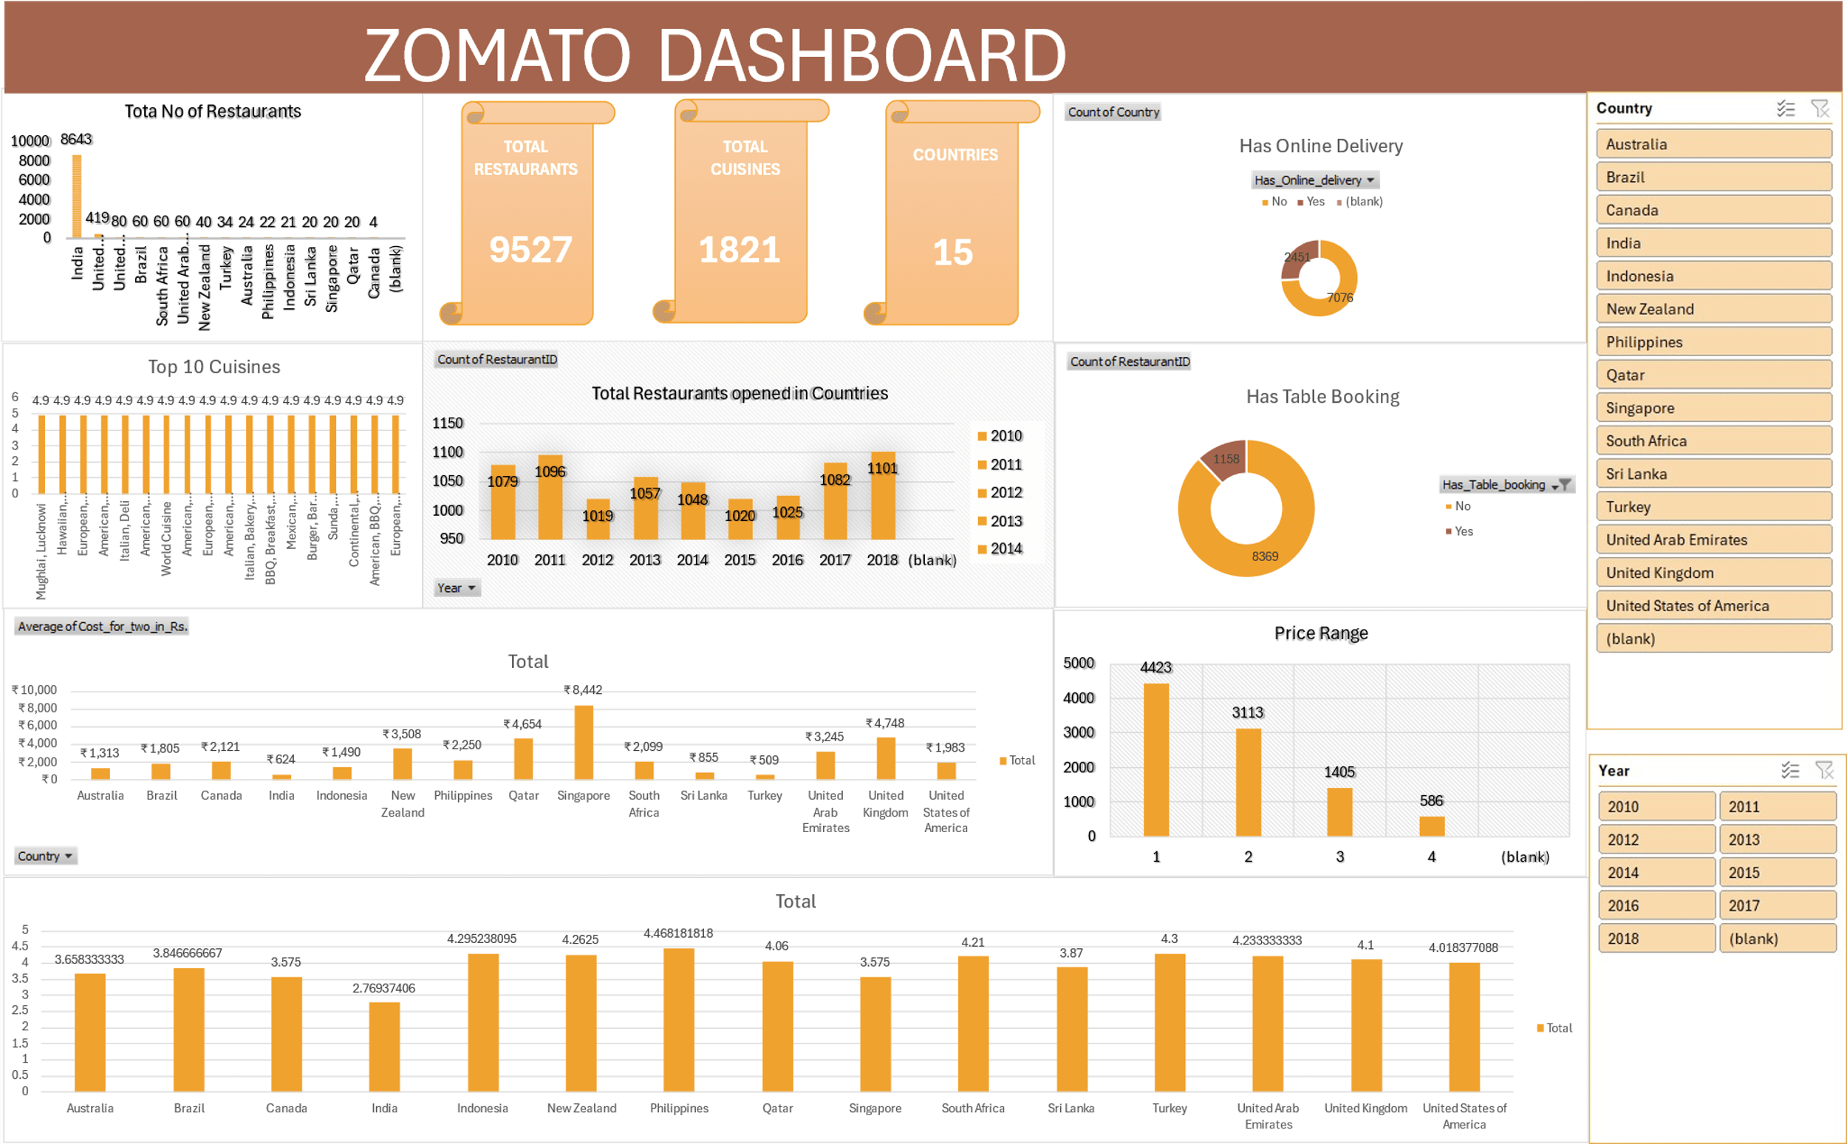
ZOMATO DASHBOARD

Slide 17
CONCLUSION
Analyzed global restaurant count per country to scope out the market saturation.
Compared average cost for two people to further narrow down our suggestions.
According to our analysis, Qatar, Singapore, Canada and Sri Lanka are the most strategic locations to open new restaurants.
All of these locations have relatively high average cost for two, less competition due to low saturation and ordinary ratings.
The reason for selecting above mentioned countries because they are very popular tourist destinations and has a very less count of restaurants which means very less competition.
The reason for selecting above mentioned countries because they are very popular tourist destinations and has a very less count of restaurants which means very less competition.
Analyzed other factors also to determine which country we can expand and open more restaurants like which cuisines are mostly liked, is the restaurant offer online table booking and delivery option, average cost spend for two, rating of the restaurants.

Slide 18
THANK YOU

